Slide 1
Live Beyond
Talking points on campaign background and development
July 2024

Slide 2
Live Beyond Background
Campaign one-pager available here

Slide 3
Campaign background
The Live Beyond healing-centered campaign is a key component of the Children and Youth Behavioral Health Initiative (CYBHI), California’s groundbreaking, multibillion-dollar effort to transform how the state supports children, youth, and families. Centering the needs of young people and uniting the efforts of the agencies and organizations that serve them, CYBHI is dedicated to ensuring young people and families can find support for their emotional, mental, and behavioral health needs.
The Office of the California Surgeon General (CA-OSG) has developed the Live Beyond campaign focused on raising awareness and understanding of Adverse Childhood Experiences (ACEs), toxic stress, and their potential negative impacts.

Slide 4
Campaign goals
The Live Beyond campaign was created to increase public understanding of Adverse Childhood Experiences (ACEs) and toxic stress and help youth and young adults across California with resources and strategies to manage toxic stress, heal from adversity, and end cycles of trauma. Overall, Live Beyond aims to:
Increase awareness and knowledge about ACEs and toxic stress, and the science behind their potential impacts on people’s everyday lives — including physical and mental health and interpersonal relationships, among others.
Influence attitudes about help-seeking by sharing stories of healing.
Build skills with accessible tools and resources that provide scientifically proven, culturally relatable, and actionable steps to heal and manage stress.
Inspire action to overcome the impacts of ACEs and toxic stress, and prevent them from cycling into future generations.

Slide 5
ACEs are common among Californians
Exposure to ACEs or other adversity, without buffering and nurturing care, can lead to a toxic stress response, which, if left unaddressed, can cause major short-term and long-term health problems for both children and adults. The more ACEs, the greater the chances of toxic stress.
ACEs are common. In California, as shown by a 2023 RAND survey:
23%
of youth and young adults have experienced 4 or more ACEs
30%
of caregivers experienced 4 or more ACEs
60%
of youth and caregivers have experienced at least 1 ACE
10%
of youth and caregivers are aware of ACEs
RAND briefing from statewide pre-campaign baseline survey (n=1,179) of youth and young adults (16-25) and caregivers of youth in English and Spanish launched in Oct. 2023. Post campaign planned for 2025.
5

Slide 6
Who is the campaign reaching?
The Live Beyond campaign is reaching
Youth and young adults (ages 16-25) as the primary audience, followed by
Parents and caregivers of youth, in addition to
Other adults in the community that support youth
The campaign is focused on reaching BIPOC audiences, in addition to economically disadvantaged, system-impacted, rural, Tribal/Indigenous, 2SLGBTQIA+ communities, and more. Campaign written materials are provided in English, Spanish, Arabic, Vietnamese, Tagalog, and Simplified Chinese.
Primary audience: Youth and young adults
(emphasis on ages 16-25)
Secondary audience: Parents and caregivers (emphasis on those with youth ages 8-16)
Tertiary audience: Other adults supporting youth, including health care providers, educators, and more

Slide 7
Definitions and Terms

Slide 8
What are ACEs?
Adverse Childhood Experiences (ACEs) are stressful or potentially traumatic events that happen to us before the age of 18. They can be a single event or an ongoing struggle where a person’s safety, security, trust, or even sense of self is threatened or violated.
Examples of ACEs include abuse, neglect, growing up in a family with parental substance use or mental health problems, divorce, parental incarceration, or domestic partner violence, and loss of a parent due to separation, death or abandonment.
In addition, other childhood adversities such as discrimination, poverty, racism, community violence, separation from a parent due to immigration or foster care, and intergenerational or cultural trauma are also risk factors for toxic stress and can lead to negative health and social outcomes.
When those adverse experiences are not buffered by a caring adult or supportive environment, or when they are prolonged, intense, or persistent, they can cause a toxic stress response. That response can affect a child’s developing brain and body and have a negative ripple effect on their physical, mental, emotional, and relational health and social outcomes. Some individuals will experience these negative outcomes, whereas others will not.

Slide 9
What are the impacts of ACEs?
The impacts of ACEs refer to the physical, mental, emotional, and relational health effects. Prolonged exposure to multiple ACEs increases the chance we may experience toxic stress, but some people do not experience any adverse effects.
ACEs may be a part of our story, but they don’t determine our health or future. And the impact of ACEs isn’t solely determined by the number of challenging events experienced, but also by our biology and the presence of protective factors that can buffer our stress response to ACEs.
It’s important to remember that ACEs are not our fault, and while we don't have control over when or why they happen, we can live beyond ACEs and take steps.

Slide 10
What is toxic stress?
Toxic stress is the prolonged, excessive activation of the stress response due to exposure to stressful and potentially traumatic events, like ACEs. Toxic stress can disrupt the development of brain architecture and other organ systems, and increase the risk for poor physical and mental health.
When the stress response system is activated over and over again, at some point, our brains and bodies adapt and become really good at detecting and reacting to threats, even when the threat is no longer around. It may go from being adaptive and life saving to potentially maladaptive and health damaging.
Toxic stress triggers an ongoing activation of the body’s stress response and requires positive, buffering experiences to help regulate the process and go back to a balanced state.
Toxic stress is the repeated activation of the stress response which can lead to disruptions in neurologic, endocrine, metabolic, and immune systems. This can affect our physical and mental health, as well as our emotional well-being and relationships well into adulthood.
In addition to ACEs, exposure to other adversities, like racism, discrimination, poverty, and housing and food insecurity, are also risk factors for toxic stress and its associated negative health and social outcomes.

Slide 11
The relationship between toxic stress and ACEs
ACEs sometimes lead to toxic stress.
ACEs are stressful or potentially traumatic events that occur before the age of 18.
Toxic stress is the prolonged and intense activation of the body’s stress response that can lead to poor mental and physical health outcomes.
As the number of ACEs we experience increases, so does the risk for serious diseases and conditions.
Toxic stress, which can happen as a result of ACEs, is particularly harmful during childhood because a child’s brain and body are just developing. Left unaddressed, toxic stress can cause fundamental changes to a child’s developing brain, immune and hormonal systems, and that can increase the risk of illness, and make life, interacting with others, and learning more challenging.

Slide 12
Live Beyond development

Slide 13
A campaign for and by youth
The Live Beyond campaign was created with and for youth and young adults ages 16 to 25 who have experienced ACEs. This is the first campaign in California about ACEs with youth and young adults as the priority audience.
Adolescence is a unique time to develop knowledge, reflect on and make sense of experiences, and more importantly, build skills in managing emotions, relationships, and stress that can carry on through to adulthood.
The campaign is grounded in science, market research, and best practices, and guided by subject matter experts, including the former California Surgeon General Dr. Nadine Burke Harris and the UCLA-UCSF ACEs Aware Family Resilience Network (UCAAN) Youth and Young Adult Advisory Board.
Informed by insights from listening sessions and focus groups with priority audiences throughout the state, the campaign will honor that people have something to give and need agency in their healing, acknowledge that healing isn’t linear and happens in relationships and communities, deliver accessible and realistic options for healing and support, and information on how everyone can and needs to play a role in creating supportive environments for youth and young adults in their communities.

Slide 14
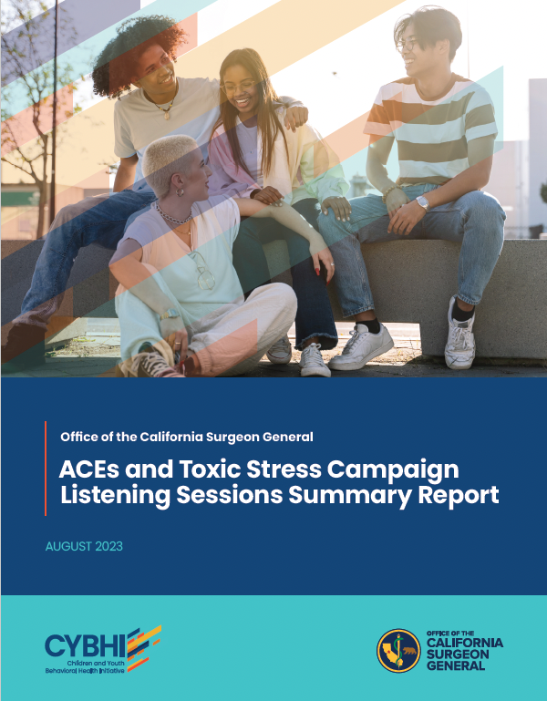
Listening sessions first held to inform development
7
Listening sessions from July to September 2023 were held with diverse participants across the state in English and Spanish
86
Participants across the state engaged
Listening session report available at osg.ca.gov/theacescampaign.

Slide 15
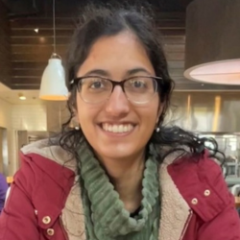
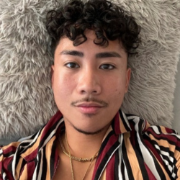
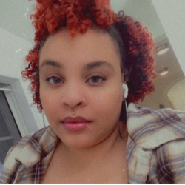
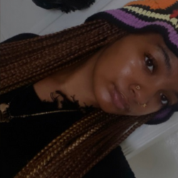
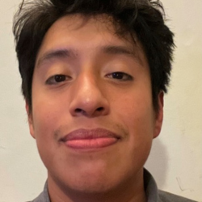
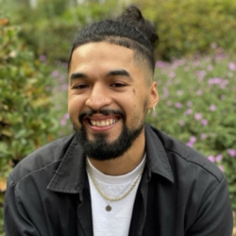
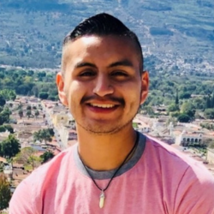
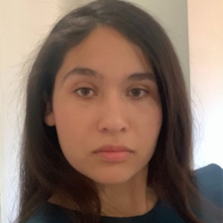
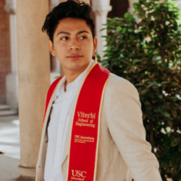
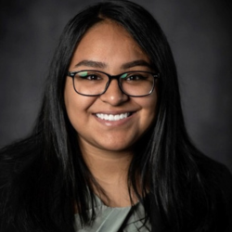
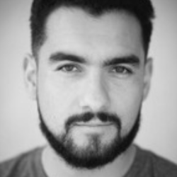
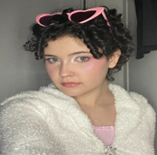
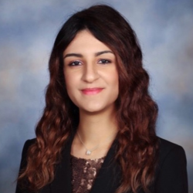
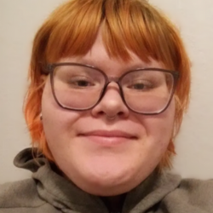
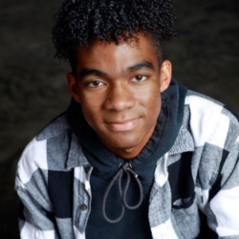
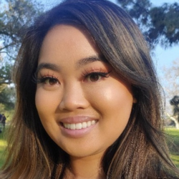
Youth advisory regularly convened
In partnership with ACEs Aware, a youth and young adult advisory council is convened monthly to listen, ideate, co-create, and review Live Beyond campaign creative, messaging, and materials.
Baani Sabharwal
Celeste Walley
Celina Inzunza
Christian Jeff Yu Menguito
CiCi Williams
Elita Jasmine Young
Jose Cruz
Josue (Swey) Pineda
Julio Sagastume
Laura Avila
Luis Wualdemar Tun Orozco
Jada Imani Carter
Representation in the group from the following counties: Alameda, Fresno, Imperial, Los Angeles, Madera, Orange, Sacramento, San Joaquin, San Diego, San Francisco, Santa Barbara, Stanislaus, and Ventura Counties
Nancy Martinez Urieta
Ronaldo (Ronnie) Villeda
Juniper Brown
Setareh Harsamizadeh Tehrani
Shae Dellamaggiore
Shamar Knox
Sharon Tang
Zen’Ayah (Zee) Finley

Slide 16
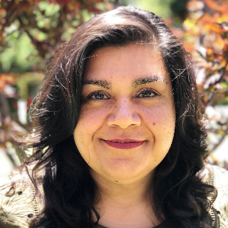
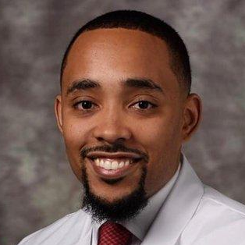
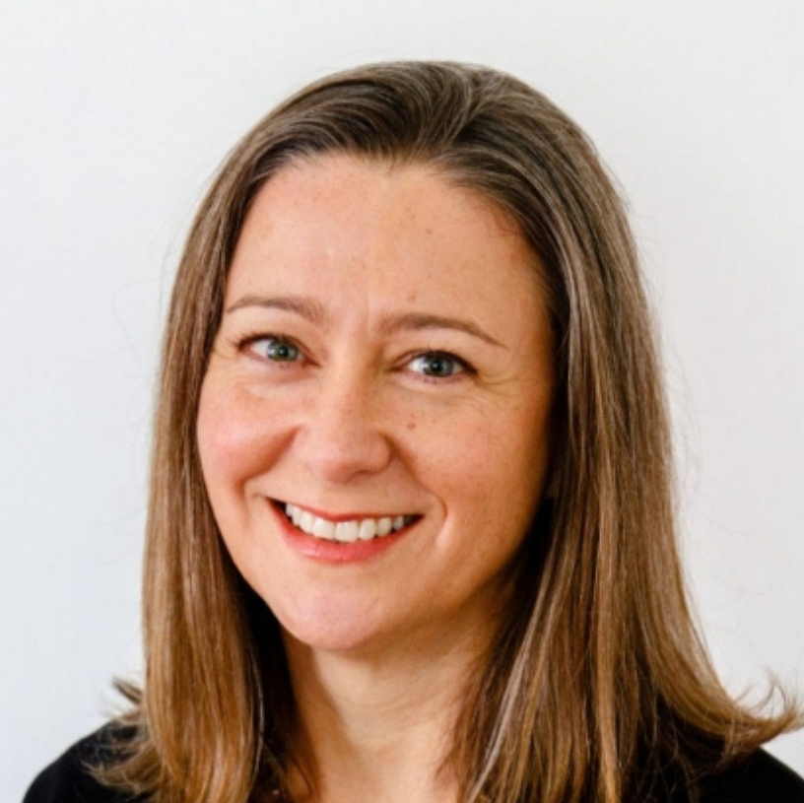
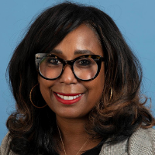
Campaign subject matter experts advisory
Cecilia Ayón
Professor, School of Public Policy, UC Riverside
Nadine Burke Harris, MD, MPH
First and Former CA Surgeon General
Mikah Owen, MD, MBA, MPH
Senior Director, UCAAN
Rachel Gilgoff, MD, CCTP, FAAP
Advisor, UCAAN
Eraka Bath, MD
Associate Professor in the Division of Child and Adolescent Psychiatry, UCLA
John R. Blosnich, PhD, MPH
Director, Center for LGBTQ+ Health Equity at the Suzanne Dworak-Peck School of Social Work (USC)
Michèle Evans, MD, MPH
Northern California Regional Medical Director of the Kaiser Permanente Child Abuse Services and Prevention (CASP)

Slide 17
Campaign Name
The name of the campaign, Live Beyond, was chosen as a result of extensive testing and feedback with youth and young adults across California as the name evoked feelings of hope, optimism, positivity, assurance, promise, encouragement, and empowerment. This emotional connection is essential to encourage audiences to trust, connect with, and engage with the campaign. Genuine and future-focused, the campaign acknowledges past trauma and hurt but emphasizes hope and the path forward to live beyond ACEs.
The Live Beyond campaign builds on existing ACEs and toxic stress campaigns and initiatives such as Stronger Starts, Number Story and ACEs Aware, but with a unique focus on youth and young adults who have experienced one or more ACEs.

Slide 18
Insights and learnings from youth

Slide 19
Barriers shared by youth about ACEs, toxic stress, and healing
 | Feelings of stigma and shame about past experiences |  | “Help” can be hard to find for many
 | Different stages of willingness/ability to seek out support for ACEs, toxic stress, and their effects |  | Healing isn’t linear and the journey isn’t always clear: no false promises that people can quickly be “healed”; rather, we need to recognize healing is defined differently among individuals and can take time
 | Burden on youth: Pressure on young people that “it's up to them” to change history/cycles of trauma. Yet many participants noted that they felt compelled to take action when they became aware of how their ACES have affected their behavior or relationships |  | Acknowledging root causes/systemic issues that perpetuate ACEs or impacted parents/caregivers; taking care not to blame parents/caregivers in any way, shape, or form
 | Mistrust of support resources, and varied willingness to seek out professional support

Slide 20
Perspectives from youth participants
“I think something very impactful is having someone who has been through the process of healing talk about how hard the struggle can be to bounce back from tough experiences. Give concrete experiences of the struggle they went through and be honest if they still don't feel like they're completely healed. It gives other youth hope that they can get better but also that it's okay to not be perfectly healed.”
“It is important to show that young people are not alone and that there is a reason for what they are feeling and experiencing, both mentally and physically.”

Slide 21
How do youth want this campaign to make them feel?
Hopeful
Safe
Deserving
Supported
Understood
Empowered
Driven (to take action)

Slide 22
Grounding insight for our campaign
While healing isn’t linear, there are small things you can do today and big things you can do in the future to heal and grow from the effects of ACEs and toxic stress.

Slide 23
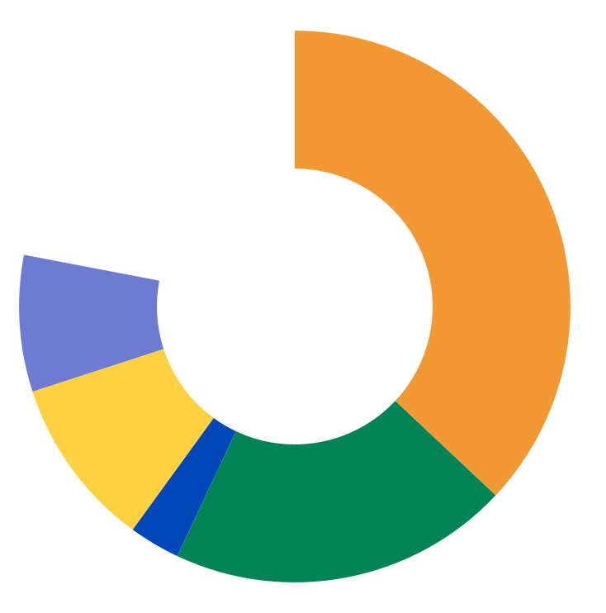
Input on campaign across the state
177 youth and young adult, parent and caregiver, and Spanish-speaking participants participated in feedback sessions
Age ranges: 16-25 years for youth and young adults; 30-45 years among parents and caregivers
14% self-identified as 2SLGBTQIA+
12% self-identified with current/former child welfare involvement
29% indicated experience with mental health challenges
White
22%
Hispanic/Latinx
37%
Participant
self-identified
race and
ethnicity
Mixed or Other Race
8%
AAPI 10%
Black/AA 20%
American Indian/Alaskan Native
3%

Slide 24
Campaign resources for youth, CBOs,
and more

Slide 25
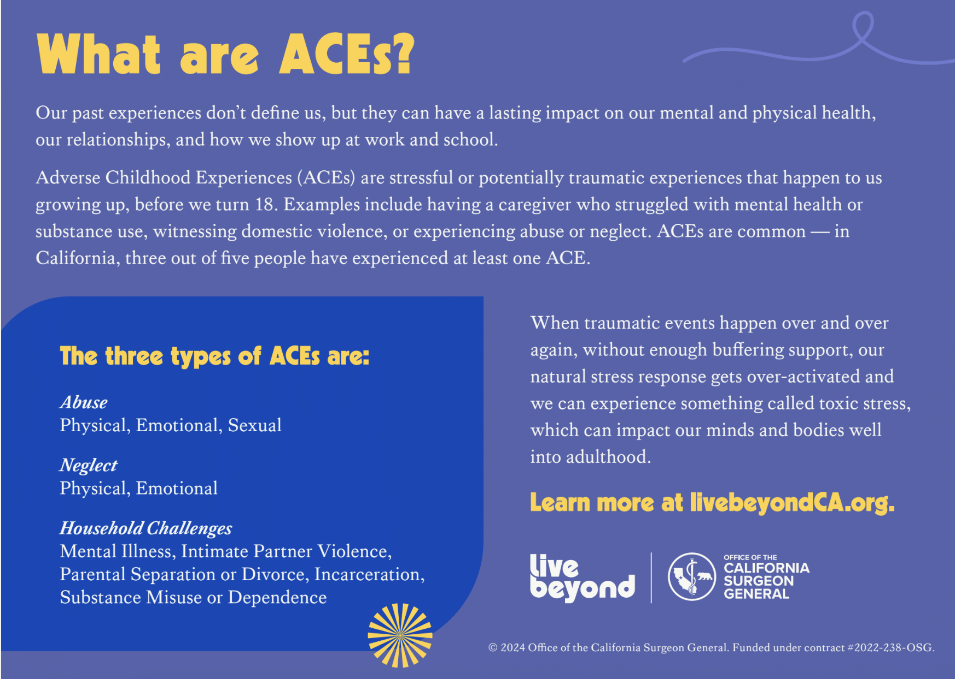
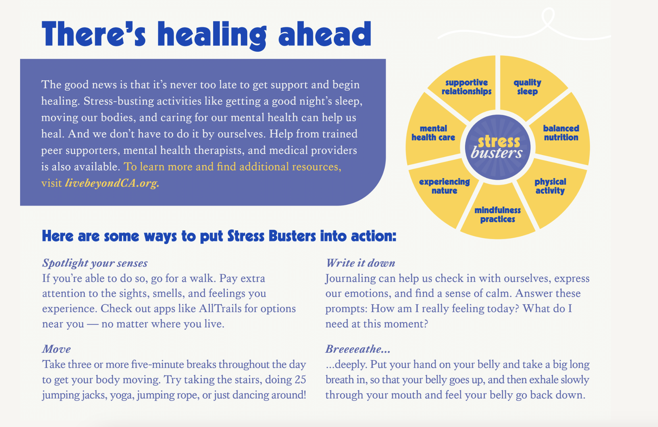
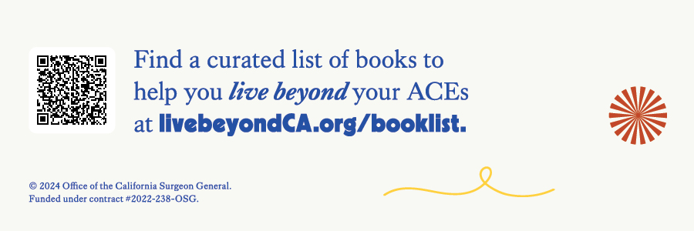
Healing journal
Palm card
Bookmark with reading list
https://livebeyondca.org/campaign-resources/
Various resources available in English, Spanish, Arabic, Tagalog, Vietnamese, Simplified Chinese

Slide 26
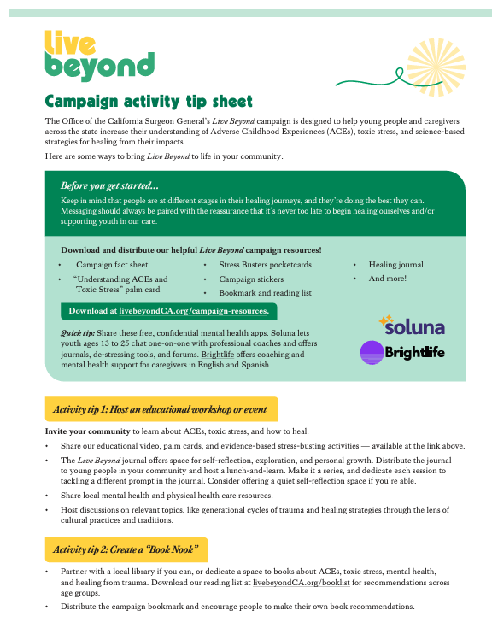
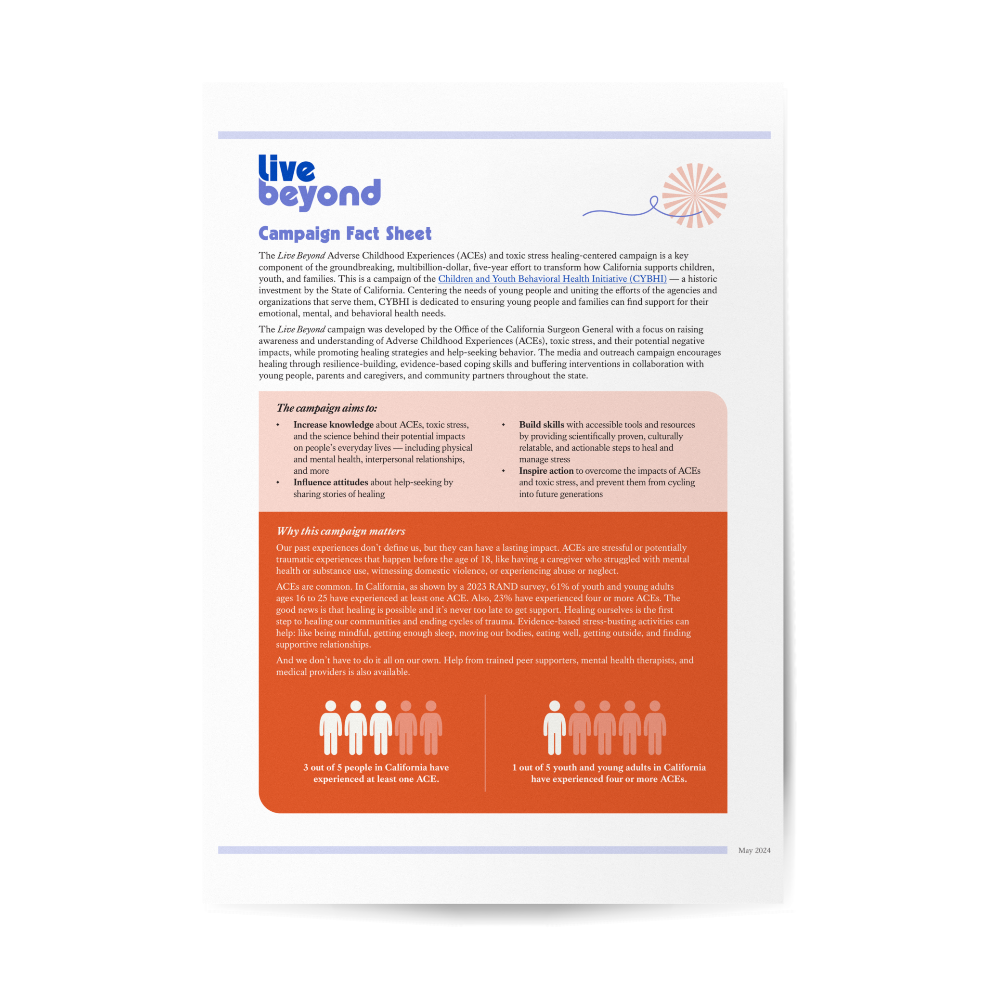
Stickers
Fact sheet
Campaign Activation Ideas
Stress Buster accordion pocket card
https://livebeyondca.org/campaign-resources/
Various resources available in English, Spanish, Arabic, Tagalog, Vietnamese, Simplified Chinese

Slide 27
Follow our campaign socials!
@livebeyondca
LiveBeyondCampaign
@livebeyondca
#LiveBeyondACEs

Slide 28
For additional questions or support, please contact the Live Beyond team at: info@livebeyondca.org

